Slide 1
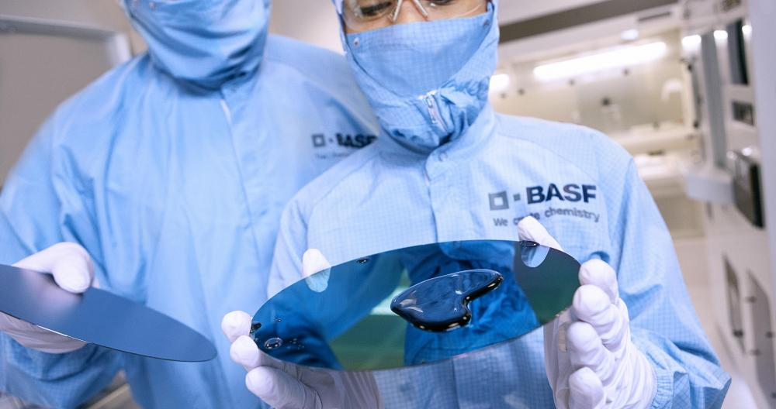


INNOVACIÓN QUÍMICA PARA LOS ODS 2030
Asamblea SusChem 2020
Iván Albertos – Octubre 2020

Slide 2
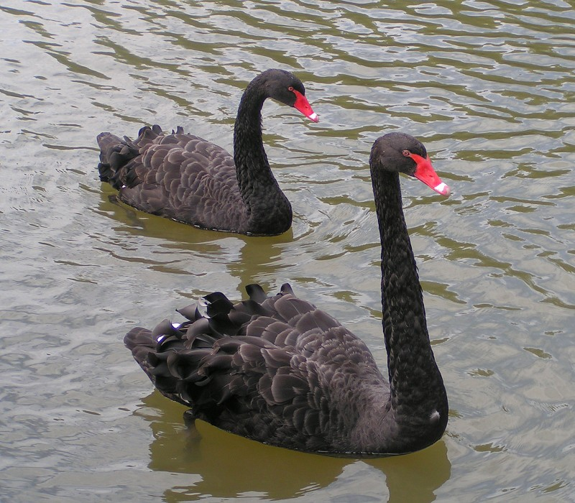

Hay asuntos relevantes que continuan en la «nueva normalidad»
Cisne negro: COVID-19, desaceleración económica, continudad de los negocios, etc.

Slide 3
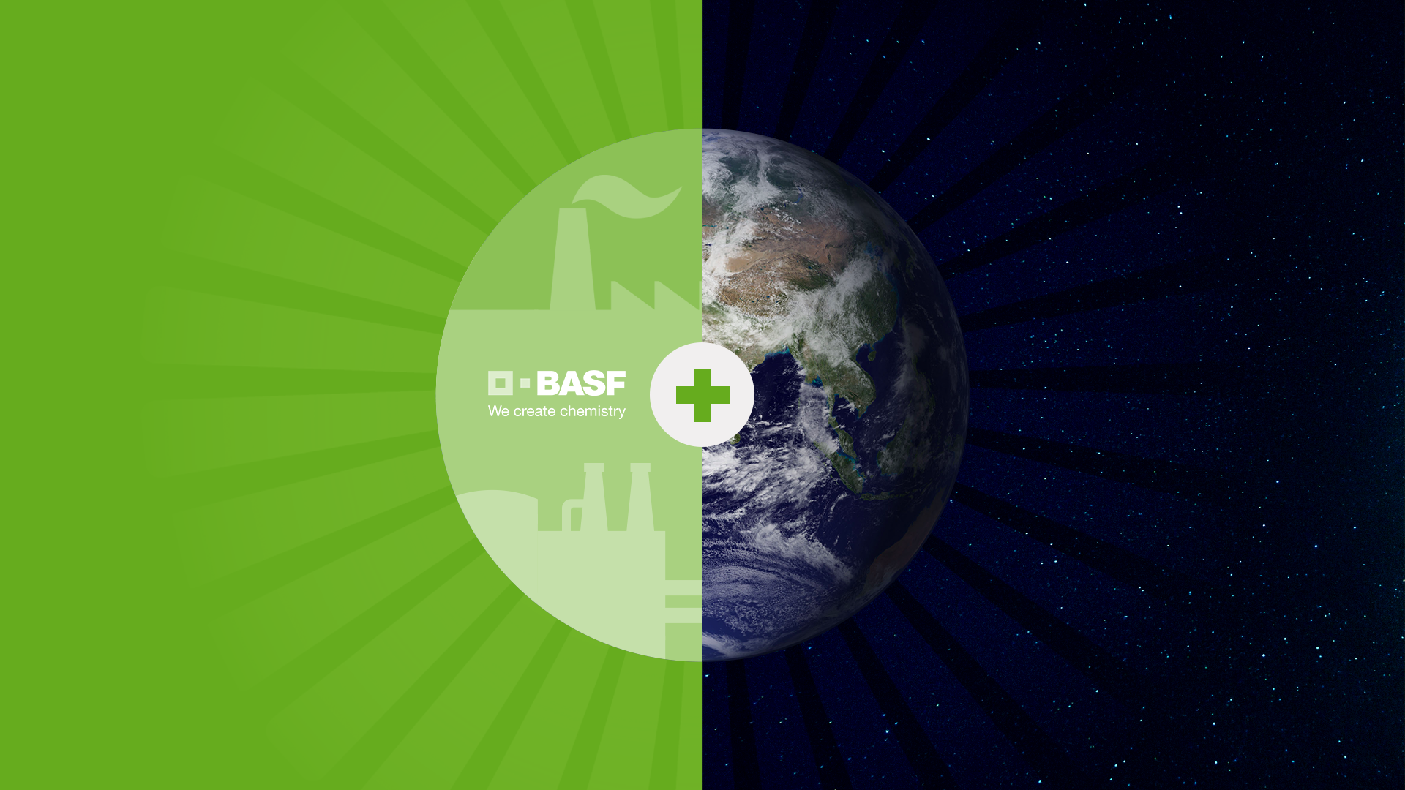
Nuestro propósito
Creamos química para un futuro sostenible
Definition
Business success tomorrow
means creating value for the
environment, society and business
El éxito empresarial del mañana significa crear valor para el medio ambiente, la sociedad y los negocios
Strictly Confidential
Notes:
XXX
XXX

Slide 4
Sostenibilidad en toda la cadena de suministros
Proveedores
BASF
Clientes
Aspectos de
materiales*
Compramos de
forma responsable
Producimos con
seguridad para las
personas y el
medio ambiente
Promovemos soluciones sostenibles
Producimos de
forma eficiente
Valoramos a las personas y las tratamos con respeto
* Aspectos de materiales incluyen, por ejemplo, energía y medio ambiente, agua, recursos y ecosistemas, producción responsable y buen trato de los empleados

Slide 5




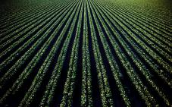


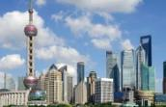


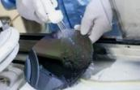

  La química facilita el camino para satisfacer las necesidades actuales y del futuro
~10bn
70%
50%
30%
…para el año 2050
…de la población mundial, en el 2050 vivirá en las grandes ciudades
…más de consumo de energía primaria en el año 2050
…más alimentos se necesitarán para el 2050
Agricultura
Salud &
nutrición
Energía &
recursos
Construcción &
vivienda
Bienes de consumo
Transporte
Material eléctrico
& electrónica
Notes:
Chemistry is an enabler to provide solutions for current and future needs
I am not sure how much you know about BASF. And no worries, I won’t bore you with a full-blown standard company presentation.
Nevertheless, I would like to tell you a little bit about us, your new “home”.
We are a big family of very diverse businesses, all dedicated to a single purpose: creating chemistry for a sustainable future.
This means chemistry in the lab and chemistry between people – with our employees, customers, society and other stakeholders.
Chemistry that makes a difference, contributes to solving global challenges.
Like the challenge of feeding a growing world population, while maintaining economic, social and environmental balance. This is where our agriculture business comes in.
Agriculture is a core part of BASF. The acquisition signals the importance of the business within BASF Group.
[Click to the next slide.]
Note to Communications:
Speaker: This chapter “Your new home” is ideally presented by someone who represents “all of BASF” (e.g. Board Member, Global / Regional President, Country MD).

Slide 6
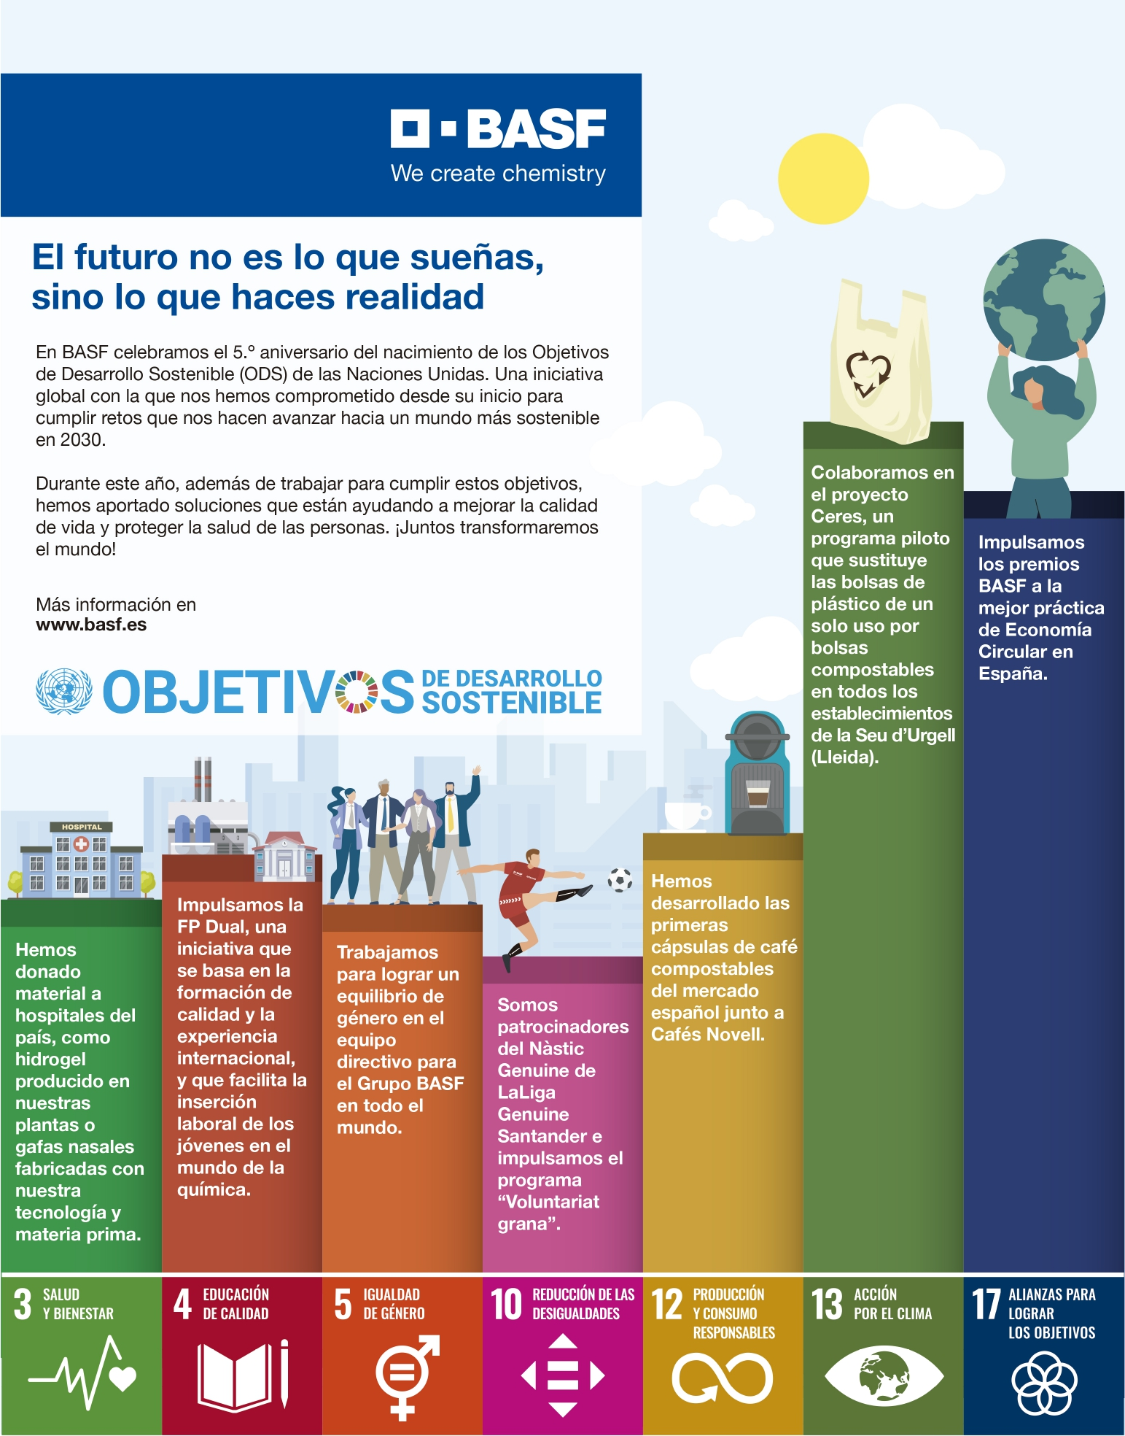
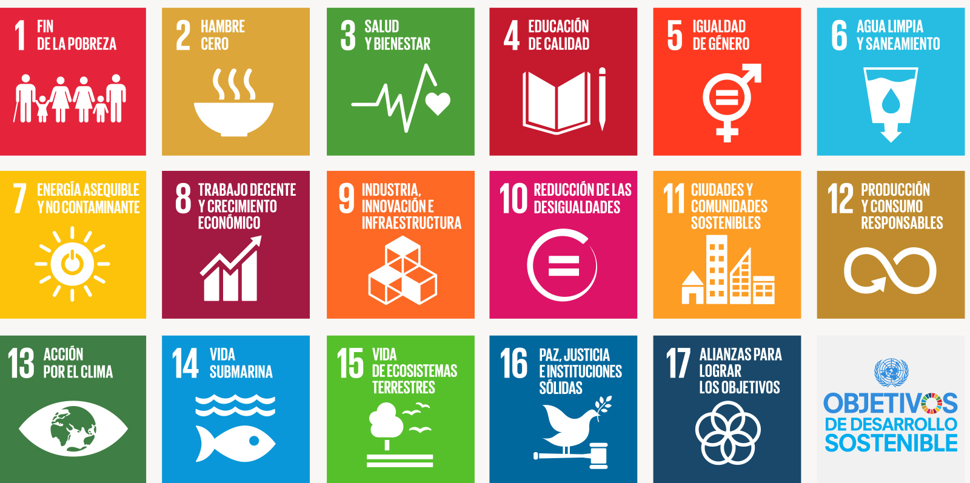
Objetivos de Desarrollo de Sostenible (ODS)
Naciones Unidas

Slide 7
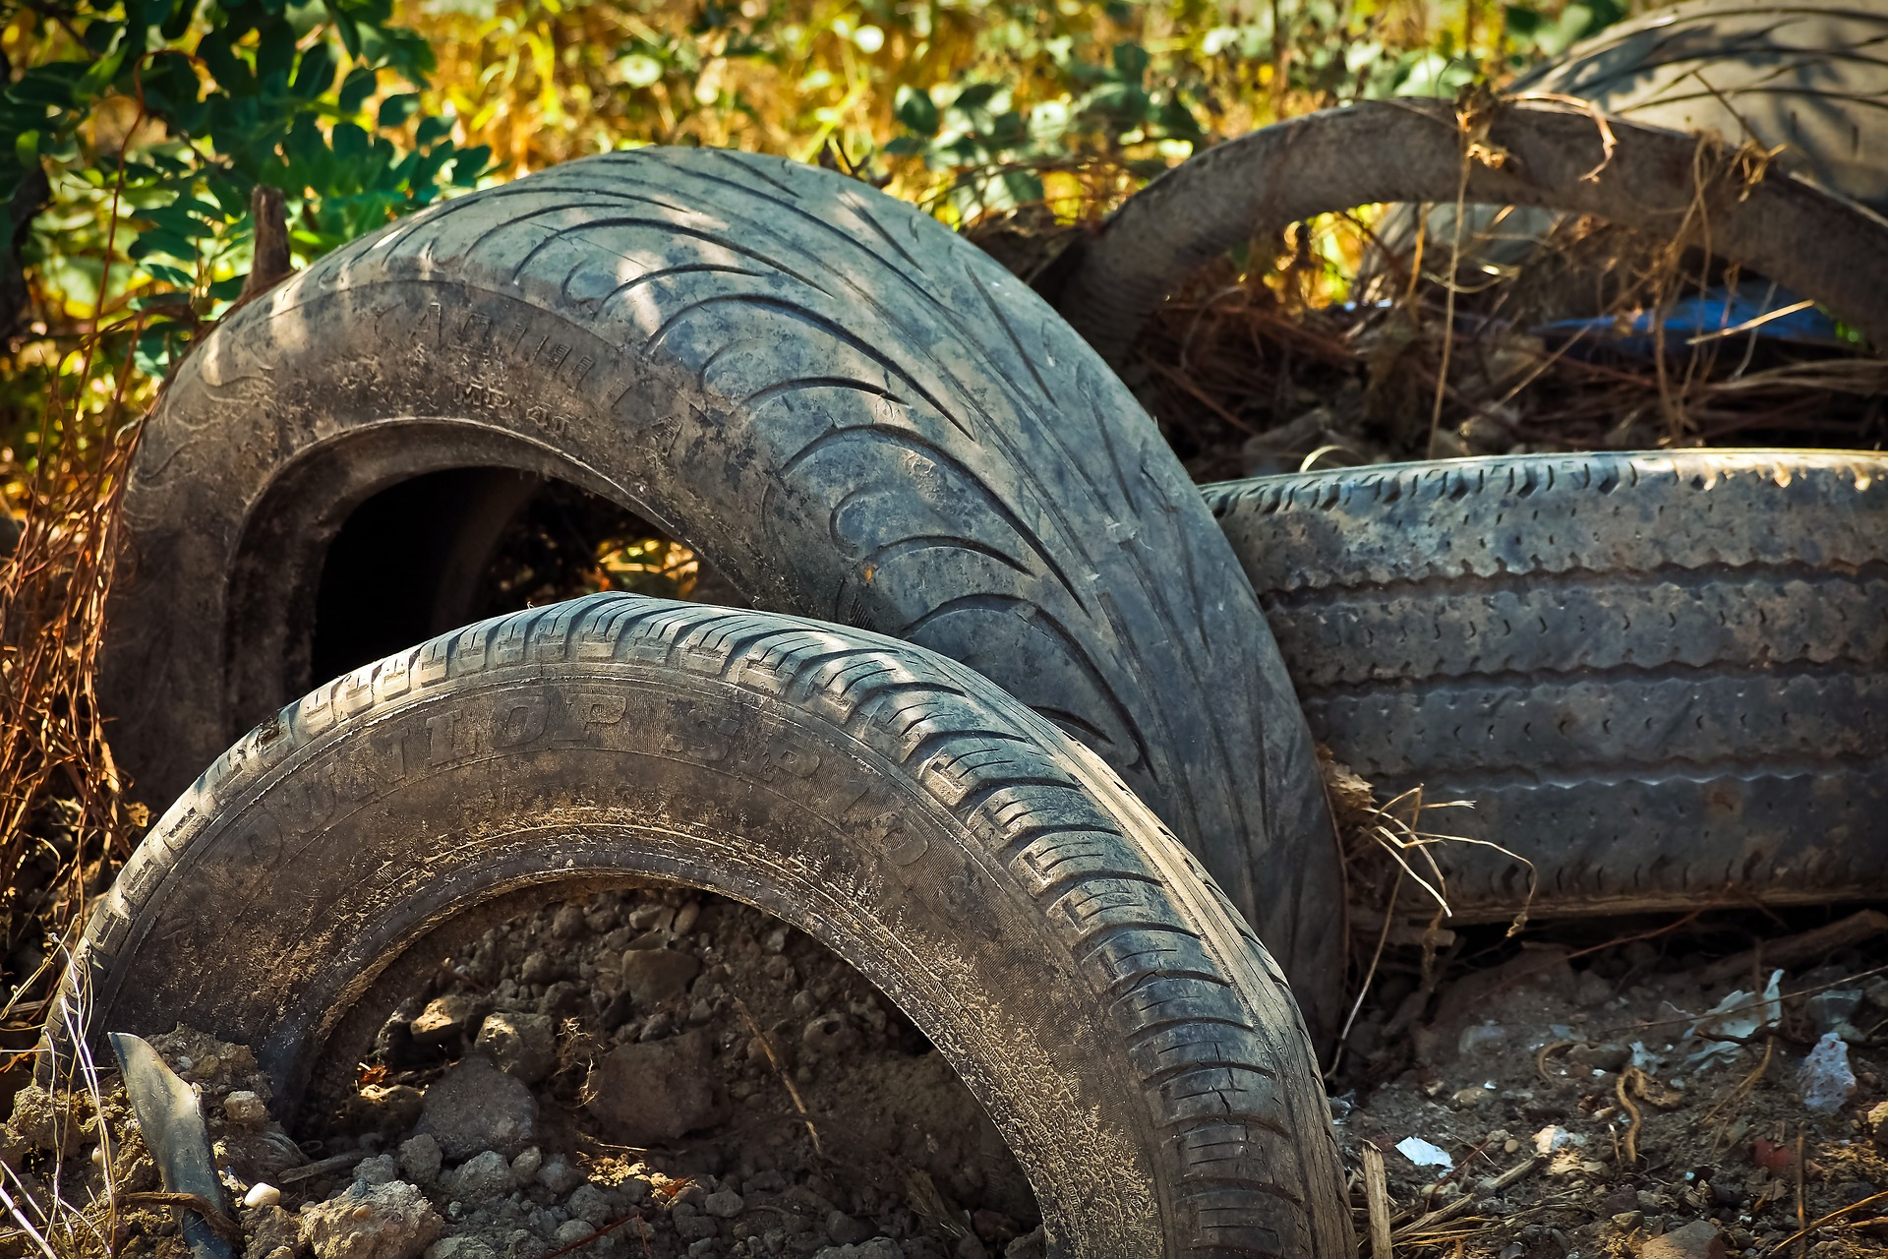

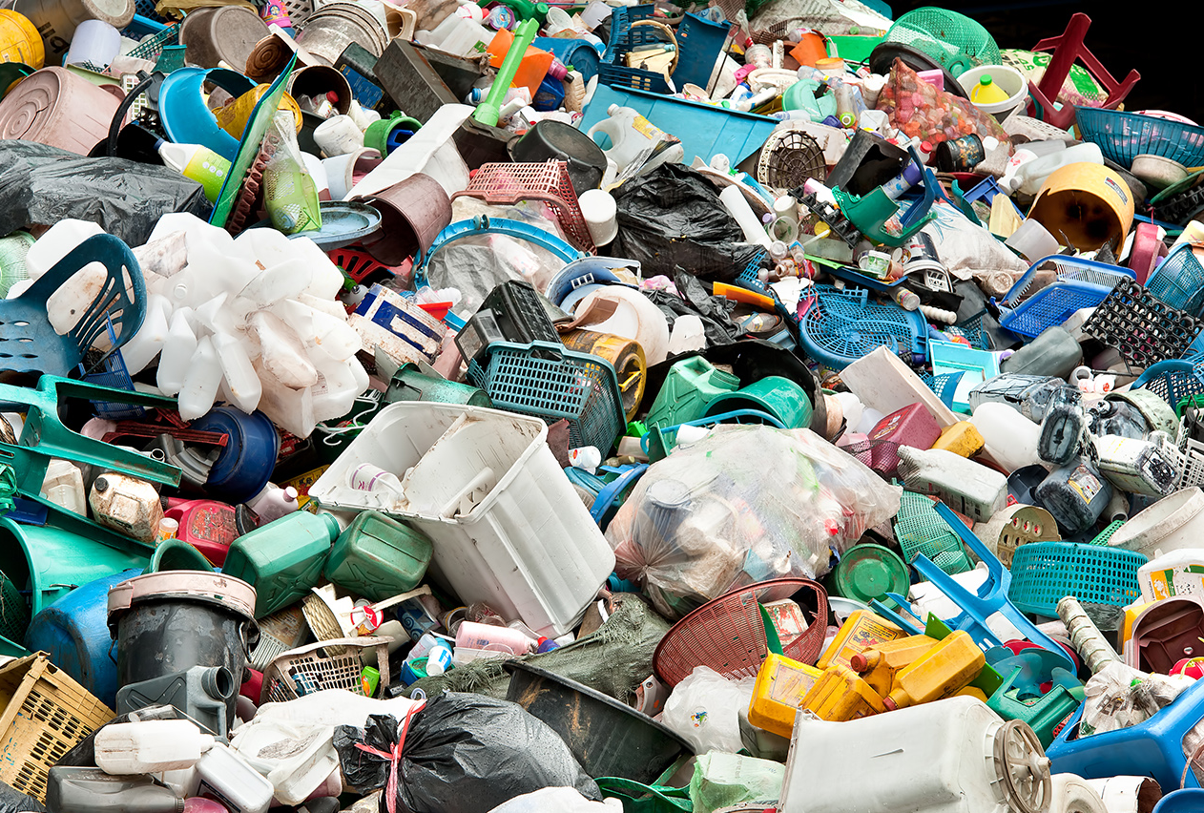


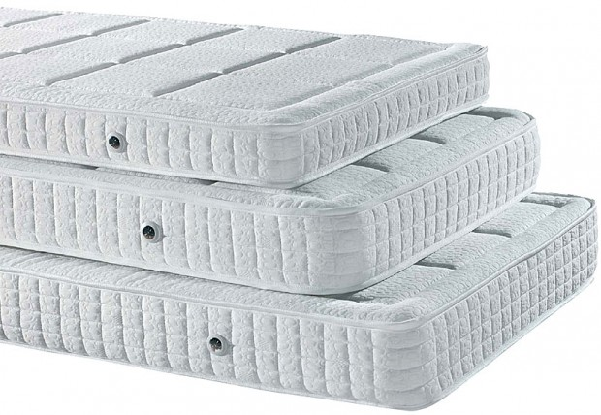
Proyecto ChemCyclingTM
Abriendo nuevos caminos en el reciclaje de residuos plásticos
Los consumidores usan y desechan productos de plástico (por ejemplo, envases, neumáticos)
Las compañías de residuos recogen y clasifican los residuos y los suministran a los socios tecnológicos de BASF.
01
06
02
Nuestros clientes utilizan estos productos químicos para fabricar sus propios productos.
BASF’s ChemCyclingTM project
Nuestros socios convierten los residuos plásticos en aceite de pirólisis mediante un proceso termoquímico.
03
05
BASF puede asignar la materia prima reciclada a todos los productos químicos producidos en sus sites a través de un enfoque de balance de masa certificado.
04
El aceite de pirólisis se purifica para usarse como materia prima al comienzo de la producción en los sites de BASF
Notes:
The ChemCyclingTM project: BASF is breaking new ground in plastic waste recycling with its ChemCyclingTM project. In this project, BASF is collaborating closely with its customers and partners, which range from waste management companies to technology providers and packaging producers, to build a circular value chain for plastics.
The cycle:
Consumers use and dispose plastic products (e.g. packaging, tyres).
Waste companies collect and sort the waste and supply our recycling partners with it.
Plastic waste is converted into pyrolysis oil by BASF’s partners using thermochemical process called pyrolysis.
The pyrolysis oil is then purified to be used as feedstock in BASF’s Verbund production.
The recycled (or secondary) raw material is then fed BASF’s Verbund production. Under the mass balance approach, the share of recycled raw material can be allocated to all chemicals produced in this Verbund.
Our CcycledTM sales products have the same properties as materials made from fossil-based raw materials.

Slide 8
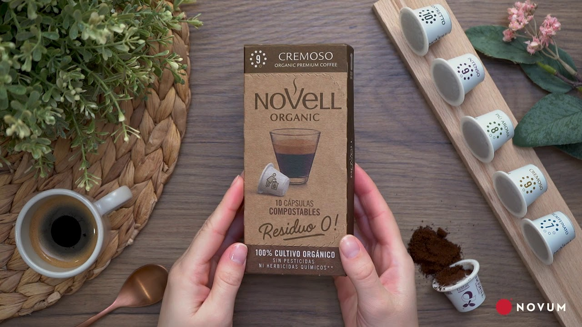
Soluciones para un futuro sostenible:
Cápsulas de café
Ecovio

Slide 9
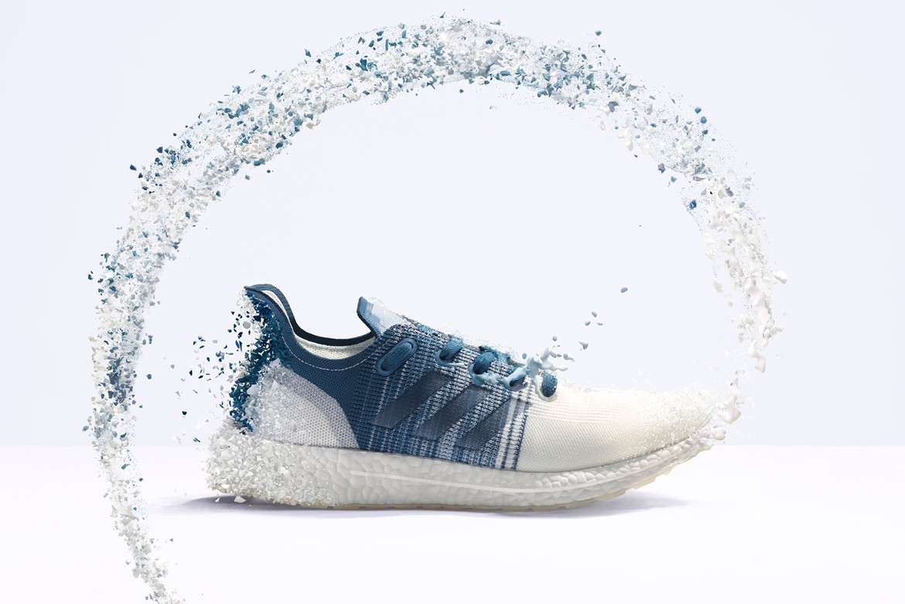
Soluciones para un future sostenible:
Adidas FutureCraft
Notes:
Examples for Accelerator solutions:
Acronal® MB – First BASF binder for interior paints based on the biomass balance approach launched in 2016. Replacing fossil raw materials with renewable feedstock at the beginning of production process: helps saving fossil resources and reducing greenhouse emissions. Enabling interior paints that combine environmental responsibility with uncompromising premium quality.
Sokalan® RO 3500 is a multifunctional antiscalant for reverse osmosis membrane treatment especially designed for water reuse applications. It is not causing eutrophication to water bodies.
Ultramid® Flex F38 contains 25 percent of bio-based raw material. The soft and strong copolymer can be applied e.g. to cheese ripening bags, agricultural films, or vacuum skin packaging.
PrimeCube® is a new technology of BASF’s Coatings division for coating truck cabins. The topcoat (“ColorPrime”) is applied wet-on-wet on the primer (“PrimeBloc”). So there is no need for drying the primer and the flash-off time is extremely reduced. PrimeCube® reduces emissions of volatile organic compounds (VOCs) and requires up to 40 percent less primary energy.
Vault® HP is a multi-component, yield-enhancing biological seed treatment system for soybeans and other dicots. The robust rhizobial inoculant improves root nodulation for more nitrogen-fixation potential, improved root architecture and nutrient uptake resulting in greater plant vigor, stress reduction, and optimized yield potential to support grower’s business and production sustainability.
Merivon® fungicide delivers advanced disease control along with the proven AgCelence® benefits / Plant Health. In grapes the product improves marketable quality by increasing the bunch weight, reducing the cracking and shattering of the berries.
Natuphos® E – In today’s animal nutrition, the enzyme phytase helps pigs and poultry to ingest and absorb phosphorus, an essential mineral in feed plants. BASF’s new phytase, Natuphos® E, can release far more phosphorus for the animals from the plant than previous generations of the enzyme. Natuphos® E allows our customers to use fewer inorganic sources of phosphate in their feed production. Phytase-enriched feed also reduces the amount of phosphate excreted by pigs and poultry by 30-40%, which in turn benefits the environment. Through its elevated efficiency, Natuphos® E exceeds this figure by a third, significantly reducing phosphate pollution in soil and water.
Quick repairs are now even more efficient with Glasurit 923-610 HS Clear fast drying VOC. The new clearcoat needs no flash-off time and provides an excellent finish after only a short drying time in the oven at 60 °C panel temperature.
Source: Accelerator example collection: https://www.basf.net/irj/go/km/docs/basfnet/media/authors/docs/Sustainability/Sustainable%20Solution%20Steering%20Accelerator%20Collection.pdf.

